Slide 1
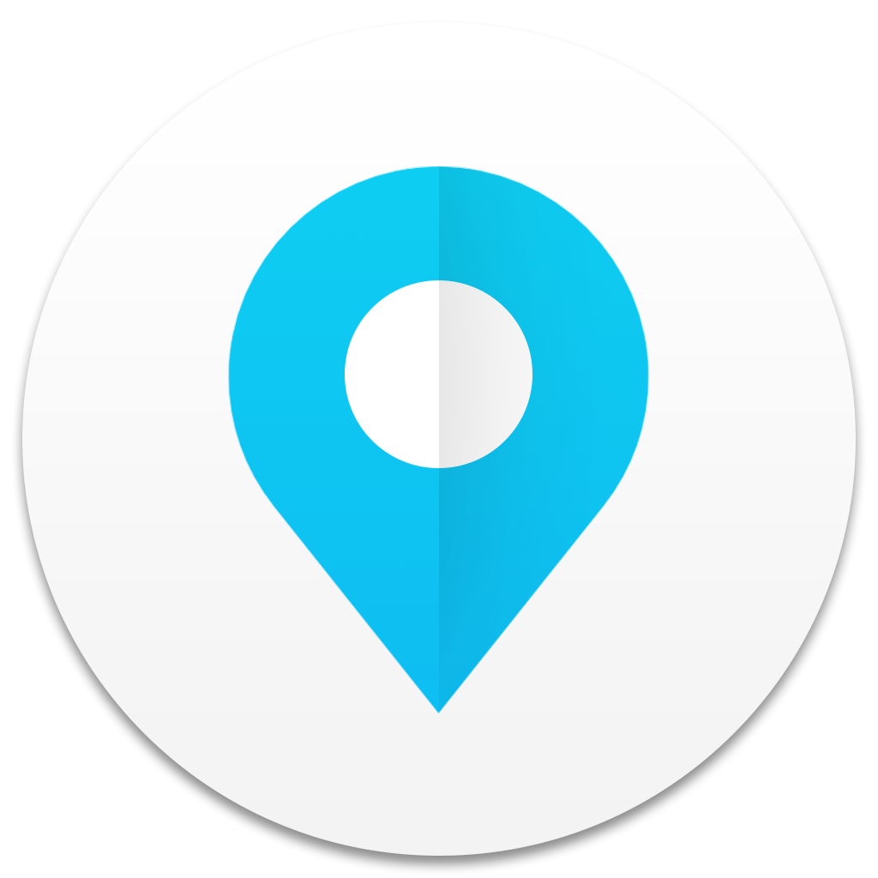
PragatiMannya

Slide 2
Validated Progress
The concept of PragatiMannya is to have a validated progress in project, as the name suggest.
The proof of progress are real-time.
PRAGATI PROGRESS
MANNYA VALIDATION
Notes:
change the contents

Slide 3
What is the Scope ?
The objectives which are achieved by PragatiMannya
Removing proxy reporting
Non-Repudiation
Full transparency
Elimination of manipulation
All data collected are fake-proof

Slide 4
How to have all objectives achieved ?
Is there any parameter which is unique ?
Is there any parameter to track the unique ?
Notes:
change the contents

Slide 5


Answer to the previous asked Question
Finger-print
GPS
The unique identity for a human being .
It cannot be easily forged without person consent.
Unique identity Solved !
The Global positioning system can track places with accuracy upto 5m
And with special accurate system may hit 3ft.
It’s the tool to track anything in the world.

Slide 6
Combining two powerful technology
The Authentication of the person who is authorized to do particular task is done with help of fingerprint matching
The authorized is tracked and validated to specific co-ordinates of the world using
GPS
To ensure the authenticated person is only allowed to take document of the subject at specified place only
Notes:
change the contents

Slide 7
Implementation

Slide 8
PragatiMannya Approach
Assigning Task
ADMIN
EXECUTION
ADMIN
VERIFIER
VERIFIER
EXECUTION
ADMIN
VERIFIER
Execution of task
VERIFIER
COMPLETE
Dr
Condition Satisfied
M
Check the identity, and location

Slide 9
How do we Assign Task ?
The app uses inbuilt fingerprint sensor hardware to authenticate the admin of the app.
The admin has list of verifiers under him to assign task.
The task details are filled and pushed to central server.
Notes:
change the contents

Slide 10
How do we Verify the task ?
The app authenticates the verifier using fingerprint sensor.
The task assigned are listed on login and task can be executed.
The current GPS location of the verifier is compared with error correction and accordingly the task is executed
Notes:
change the contents

Slide 11





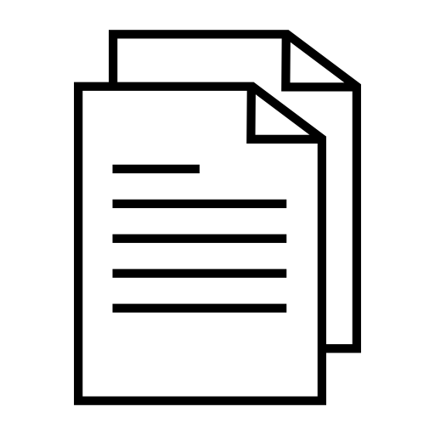


Representation
FIREBASE AUTH
(ADMIN Instance)
ASSIGN TASK
FIREBASE STORAGE
ADMIN
UPLOAD
FIREBASE
(CENTRAL)
MATCHING
FIREBASE DATABASE
(CENTRAL)
VIEW TASK
VERIFIER
FIREBASE AUTH
(VERIFIER Instance)

Slide 12
App Looks Like

Slide 13
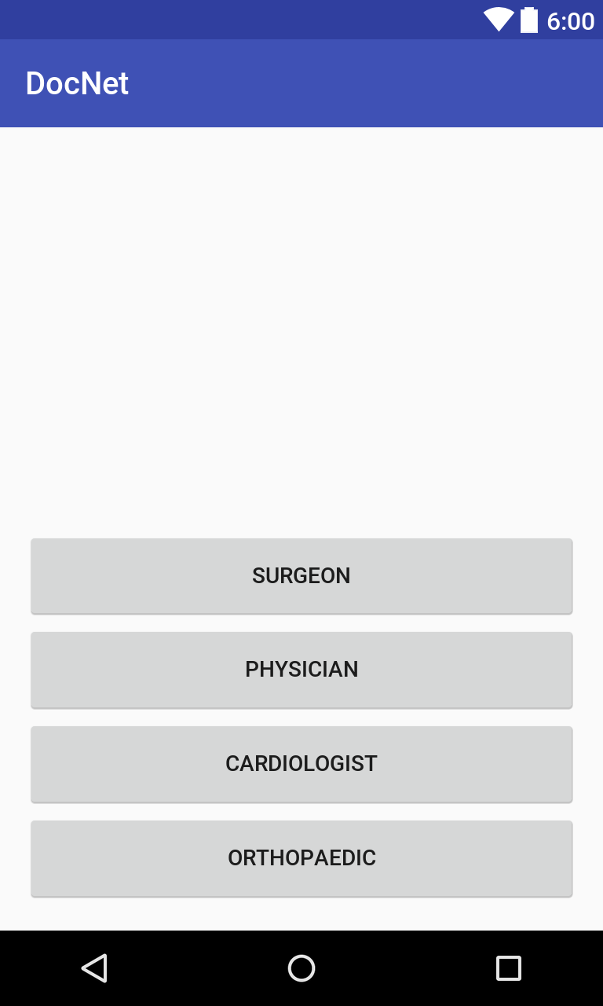
Field’s where this concept can be used

Slide 14
Fields
Government Project Verification
Road construction (Rural)
Government Beneficiaries
verification,
Ex: AwasYojna, Farmer Crop insurance ,etc..
This can be extended to any kind of certificate verification by uploading the document with
E-Sign, so even super admin cannot modify
Land Survey and Revenue Department
It can also be used for attendance monitoring

Slide 15
Technology Used
Android
Firebase
Android Studio
THANK YOU

